Slide 1




Notes:
Will update when we have final

Slide 2


Thank you!

Slide 3
Review Participation
Publish V.3 MASP Webinar w/ LARA
Concept Test MASP/MDE, N=4
Program Leader Written Promising Practices, N=10
Program Leader Interviews and focus groups, N=10
Finished product
50 contributors
Version
One
May
Version
Two
June
Version
Three
June-July
Version
Four
August
QLC Focus Group, N=10
QLC Written Feedback, N=7
QLC Written Feedback, N=5

Slide 4
Language Updates
Out of school time (OST) will replace afterschool - except when it is associated with an organization (MASP)
Individual learning environment will be used in replace of household to identify the context in which the student participates in afterschool services.
Include caregiver with family: For afterschool people, "caregivers" are the (not necessarily parent) adults who are responsible for the child while the afterschool is interacting with them.
  Example: Domain I. Family and Caregiver Centered Engagement
  Exception: Standard 2. Use Family-Centered Approaches - This one does not include caregiver because family-centered is a term of art that also includes custodial folks, parent or otherwise.
Caregiver will replace parents

Slide 5
Promising Practices
Modeling Skills. Program staff explicitly and intentionally model and promote children’s use of socio-emotional skills (e.g., emotion management, teamwork, initiative, problem solving, empathy, responsibility) during distance programming.
SEL activities are intentionally put into each of our activity boxes. Two staff attend each virtual meeting to model skills while facilitating activities and conversations. Especially in the middle school groups, we model more delicate topics, like mental health. One of our summer programming box themes is Mother Nurture, which is focused on modeling SEL skills through social and environmental activism.
Staff talk with children about how we are all dealing with the feelings and emotions that we have right now, followed by lessons that revolve around healthy coping strategies.
Staff do a warm-up where staff and children pick a planet that has a color and emotion words. We say what planet we are and why. It’s good for children because they can hear that even staff have hard days and are frustrated by not being able to socialize like we normally would or are sad because we also miss our friends.

Slide 6
Next Steps
Dissemination plan
Updates:
Weak promising practices for planning
Blog for day of week
Blog for Google classroom
Validation Study

Slide 7
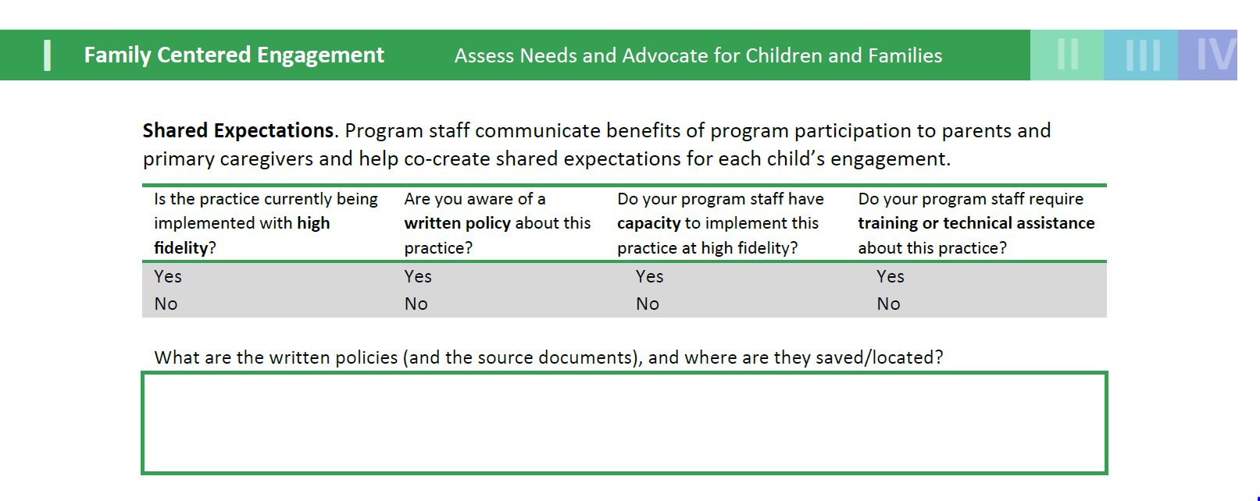
Rubrics - Michigan

Slide 8
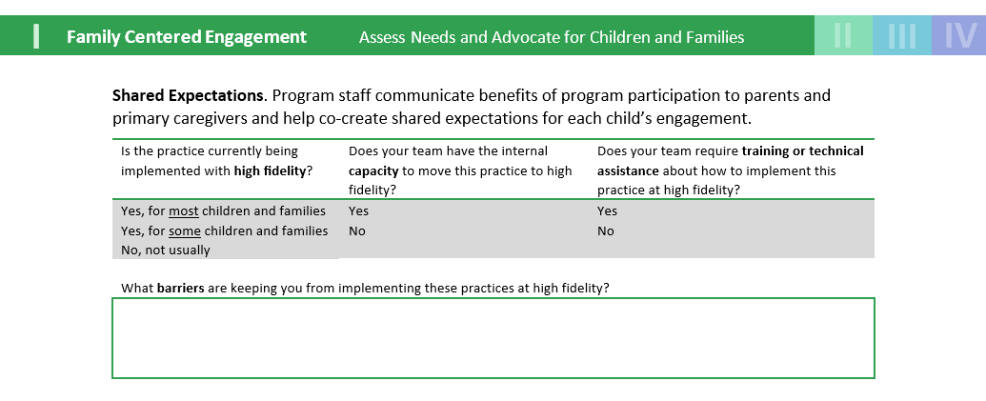
Rubrics - BLOCS

